Slide 1
DATA 200
Paramdeep Saini, SJSU

Slide 2
Week 2 - DATA 200
Questions from Week 1?
HW?
If/elif?
While loop?
Conditional Expression?
Negative Subscript?
List Operations: insert,sort,pop,reverse?
Slices?
Tuple/Dictionary/Set and their operations?

Slide 3
Variable Scope
What is Scope?
Local Scope?
variable scope restricted to block/functions
Global Scope?
Variable scope not restricted to block/functions
Generally, global variables are not a good idea. When multiple functions update global variables, the result can be difficult to predict.
sum = 100 # A global variable
def calcSum (totalSum,delta) :
global sum
# This function intends to update the global
if sum >= totalSum :
sum = sum + delta
Notes:
If you omit the global declaration, then the sum variable inside the withdraw function is considered a local variable.
Generally, global variables are not a good idea. When multiple functions update global variables, the result can be difficult to predict.

Slide 4
Quiz
Is it Correct?
def main() :
numr = 2
print(computeNumR(numr))
def computeNumR(value) :
fnum = 1
for k in range(1, value + 1) :
temp = numr
fnum = fnum * k
return fnum
main()
Is it correct?
def main() :
volume = getVolume(3)
print(volume)
def getVolume(sideL) :
volume = sideL * sideL * sideL
return volume
main()

Slide 5
Quiz
Is it Correct?
str1=“I m in global scope”
def main() :
func1()
print(“Hi”,str1)
def func1() :
str1=“you dere?”
print(“Hi”,str1)
main()
Is it correct?
str1=“I m in global scope”
def main() :
func1()
print(“Hi”,str1)
def func1() :
str1 +=“ and you dere?”
print(“Hi”,str1)
main()

Slide 6
Function
Python Functions is a block of statements that return the specific task.
Benefits
Code Readability
Code Reusability
def function_name(list_of_parameters):
# Program instructions
return expression
Types of functions
User defined
Build-in –functions e.g. print()
Notes:
If you omit the global declaration, then the sum variable inside the withdraw function is considered a local variable.
Generally, global variables are not a good idea. When multiple functions update global variables, the result can be difficult to predict.

Slide 7
Quiz
Is it Correct?
def main() :
a = 4
print(calcNum(a + 1))
def calcNum(x) :
y = x * x
return y
main()
What would be the output
def main() :
print(rfunc(4))
def rfunc(a) :
if a <= 0 :
val = 1
else :
val = a + rfunc(a - 2)
return val
main()

Slide 8
Quiz
Is it Correct? If yes, what is the output? If not why?
def main() :
print(calcAvg(5,6,7))
print(calcAvg(5,6,7,10,11))
print(calcAvg())
def calcAvg(*x) :
total=0
for val in x:
total = total + val
avg=total/len(x)
return avg
main()

Slide 9
Reading
Read about inspect module
What is role of inspect.signature(function_name)? Why it s important?
https://docs.python.org/3/library/inspect.html

Slide 10
Assignment
Is it correct? What is val1 and val2 in following case?
(val1, val2) = (20.95, 15)
val1, val2 = 20.95, 15
(val1[i], val1[j]) = (val1[j], val1[i])
(val1, val2) = (20.95, 15)
print(type(val1))
if isinstance((val1,val2), tuple):
print("Tuple")

Slide 11
Return values
Is it correct? What will be the output?
def main():
a,b,c=func1()
print(a,b,c)
def func1():
return(4,5,6)
main()

Slide 12
Files and Strings
s.lstrip()
s.rstrip()
s.rstrip(char)
s.lstrip(char)
s.split()
s.split(sep,maxsplit)
s.split(s)
s.splitlines()

Slide 13
Files and Strings
for line in infile:
print(line)
s.lstrip()
s.rstrip()
s.rstrip(char)
s.lstrip(char)
s.split()
s.split(sep,maxsplit)
s.split(s)
s.splitlines()

Slide 14
Quiz
Select the output produced by the program below, assuming that the program is executed from the command line as follows:
python op.py -h data.txt record.txt
from sys import argv
print(argv[1],argv[2])
data.txt record.txt
-h data.txt
record.py -h
Error".

Slide 15
Quiz
Select the output produced by the program below, assuming that the program is executed from the command line as follows:
python op.py -h data.txt record.txt
from sys import argv
print(argv[1],argv[2])
data.txt record.txt
-h data.txt
record.py -h
Error".

Slide 16
Quiz
Select the output produced by the program below, assuming that the program is executed from the command line as follows:
python process.py -min 80 -d record.txt
What is output of following:
len(argv)
argv[1]
int[argv[2])
argv[3]
argv[4]

Slide 17
Quiz
Assuming that mainFile already opened for writing, which one will cause the error?
mainFile.write(“This is a string”)
mainFile.write(“result = %d” % 12)
mainFile.close()
Line= mainFile.readLine()

Slide 18
Quiz
Select the output produced by the program below, assuming that the program is executed from the command line as follows:
python process.py -min 80 -d record.txt
What is output of following:
len(argv)
argv[1]
int[argv[2])
argv[3]
argv[4]

Slide 19
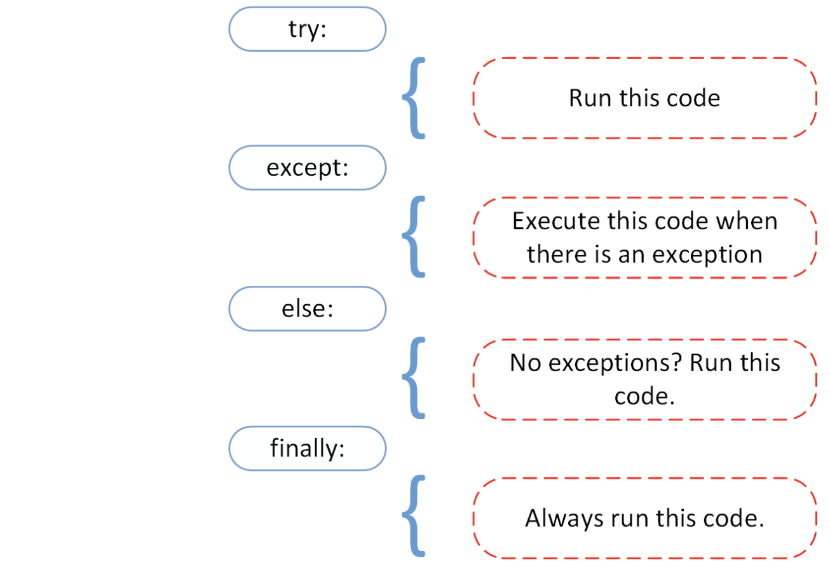
Exception
Source: https://realpython.com/python-exceptions/

Slide 20
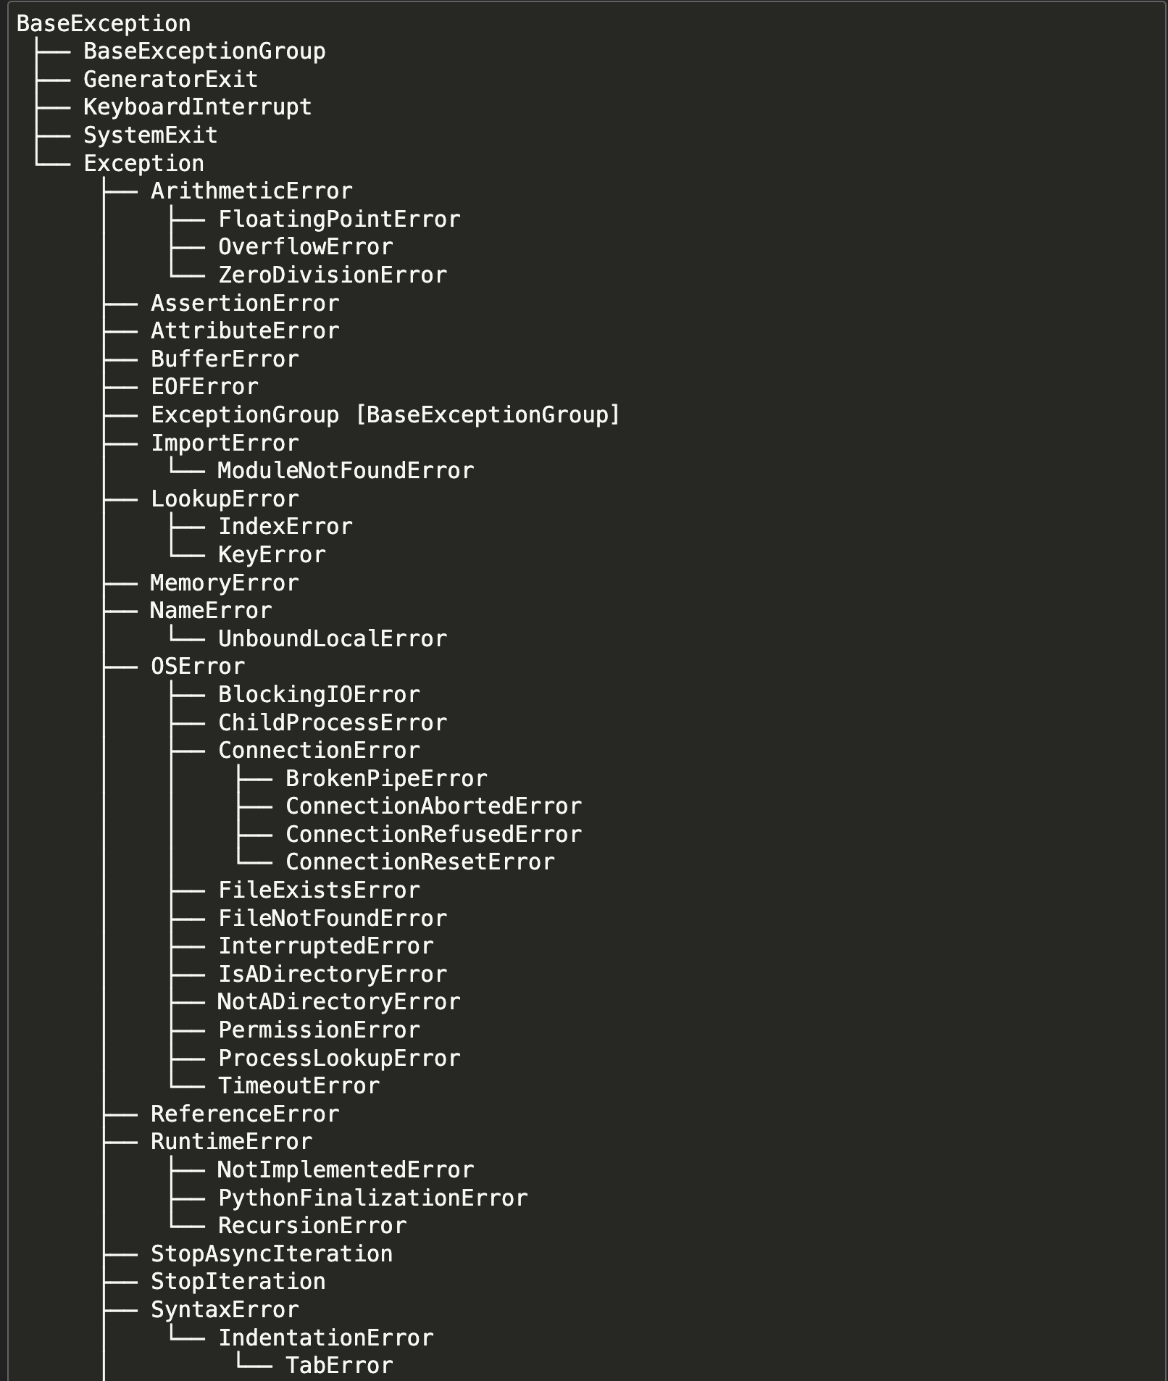
Exception
Source: https://docs.python.org/3/library/exceptions.html#exception-hierarchy

Slide 21
Quiz
Complete following when program raise an exception with an appropriate error message when variable index is negative.
if count < 0 :
--------------
raise IndexError
raise IndexError(“Negative Index”)
except IndexError
except IndexError as exception

Slide 22
Lambda
Anonymous Function
Concept derived from lambda calculus (https://en.wikipedia.org/wiki/Lambda_calculus)
def getval (y): return y | lambda y:y
def getval (y): return y * 30 | lambda y: 30 * y
print(20) | print((lambda x,y: x *y) (10,2))

Slide 23
Lambda
E.g. 1:
my_func = lambda x,y,z: (x+y) *z
print(my_func(2,3,5))
E.g 2:
my_func1 = lambda x: x+20 if x > 20 else x-10
print(my_func1(30))

Slide 24
Quiz
my_func = lambda x: return x
print(my_func(10))
Syntax Error
0
10
10.0

Slide 25
Quiz
(lambda y: (y + 3) * 5 / 2)(5)
Syntax Error
40
20
20.0

Slide 26
Quiz
(lambda y: (y + 3) * 5 / 2)(5)
Syntax Error
40
20
20.0

Slide 27
Quiz
def my_func(y):
return ''.join(y)
Convert it to lambda function?

Slide 28
Generator Function
An iterator in Python is an object that holds a sequence of values and provide sequential traversal through a collection of items such as lists, tuples and dictionaries.
Python generator functions are a powerful tool for creating iterators.
Notes:
0.0001
0.00072
5.4e8
1.0e-6
6.23596e2

Slide 29
Generator Function
Normal Function | Generator Function
def calcSum(n): count, list1 = 0 , [] while count < n: list1.append(count) count = count +1 return list1 NumSum=sum(calcSum(1000)) | def calcSum(n): count=0 while count < n: yield count count = count +1 NumSum=sum(calcSum(1000)) generator=calcSum(2) print(next(generator))
yield is used in generator functions to provide a sequence of values over time
When yield is executed, it pauses the function, returns the current value and retains the state of the function
This allows the function to continue from the same point when called again, making it ideal for generating large or complex sequences efficiently
https://wiki.python.org/moin/Generators
Notes:
0.0001
0.00072
5.4e8
1.0e-6
6.23596e2

Slide 30
Generator Expression
(expression for item in iterable)
E.g.
cubeR = (x*x*x for x in range(1,10))
for i in cubeR:
print(i)
Notes:
0.0001
0.00072
5.4e8
1.0e-6
6.23596e2

Slide 31
Quiz
Generator Function in python?
it doesn’t store content in memory
returns laze iterator
It is like lamda function
It is based on iterator pattern

Slide 32
Quiz
def gen_sequence(n):
count=0
while count<n:
------- count
count + = 1
gen1 = gen_sequence(2)
next(gen1)

Slide 33
Quiz
What is the difference between yeild and return in python?

Slide 34
Quiz
What is the difference between yield and return in python?

Slide 35
ZIP Function
The zip() function in Python combines multiple iterables such as lists, tuples, strings, dict etc, into a single iterator of tuples.
Each tuple contains elements from the input iterables that are at the same position.
names = [‘sam', ‘John', ‘Doug’,]
age = [30,20,10]
details = zip(names, age)
print(list(details))

Slide 36
Quiz
cities = [‘SFO’, ‘Chicago', ‘LA’]
populationT = [20, 10]
res = zip(cities, populationT)
print(list(res))

Slide 37
Enumerate Vs range
Range() | Enumerate => enumerate(iterable, start=0)
a = [1,2,3] for i in range(len(a)): # i is the idx | for idx, val in enumerate(a): print idx, val
For loop | Enumerate => enumerate(iterable, start=0)
count=0 la=[‘a’,’b’,’c’] for word in la: count=count +1 # i is the idx | for idx, val in enumerate(a): print idx, val

Slide 38
Enumerate and Zip
Zip and enumerate | Normal for loop
names = ['Alice', 'Bob', 'Charlie’] ages = [24, 50, 18] for i, (name, age) in enumerate(zip(names, ages)): print(i, name, age) | for i in range(len(names)): print(i,names[i],ages[i])

Slide 39
Zip with Dictionary
Zip with dictionary – Usecase1 | Forming dictionary without using zip
keys = ['a', 'b', 'c’] values = [1, 2, 3] dictionary = dict(zip(keys, values)) print(dictionary) # {'a': 1, 'b': 2, 'c': 3} | keys = ('name', 'age', 'food’) values = (‘Sam', 42, 'spam’) dict = {keys[i]: values[i] for i in range(len(keys))}

Slide 40
Quiz
subjects1={1: ‘Maths', 2: ‘Science’}
subjects2={3: ‘EE', 4: ‘CS’}
print("Dictionary1:", subjects1)
print("Dictionary2:", subjects2)
# Zip the dictionaries
zip_dict = list(zip(subjects1, subjects2))
print("Zipped dictionary:", zip_dict)

Slide 41
Coding Maths Functions
Code following:
{2x: x belongs to {1,2,3}}
{ x*y for x in {3,4,5} for y in {7,8,9}}
R->R that returns twice its input
Reading: Read about vector and its properties such as addition/subtraction/multiplication
We will discuss about document vector when you are ready with vector.

